Slide 1
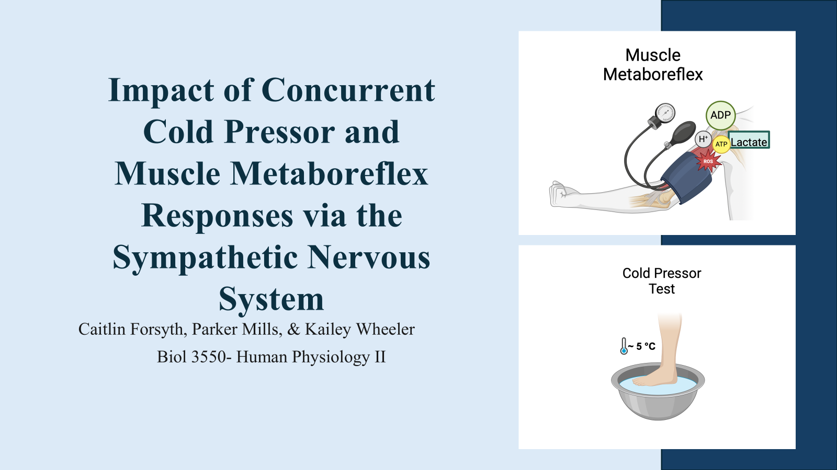
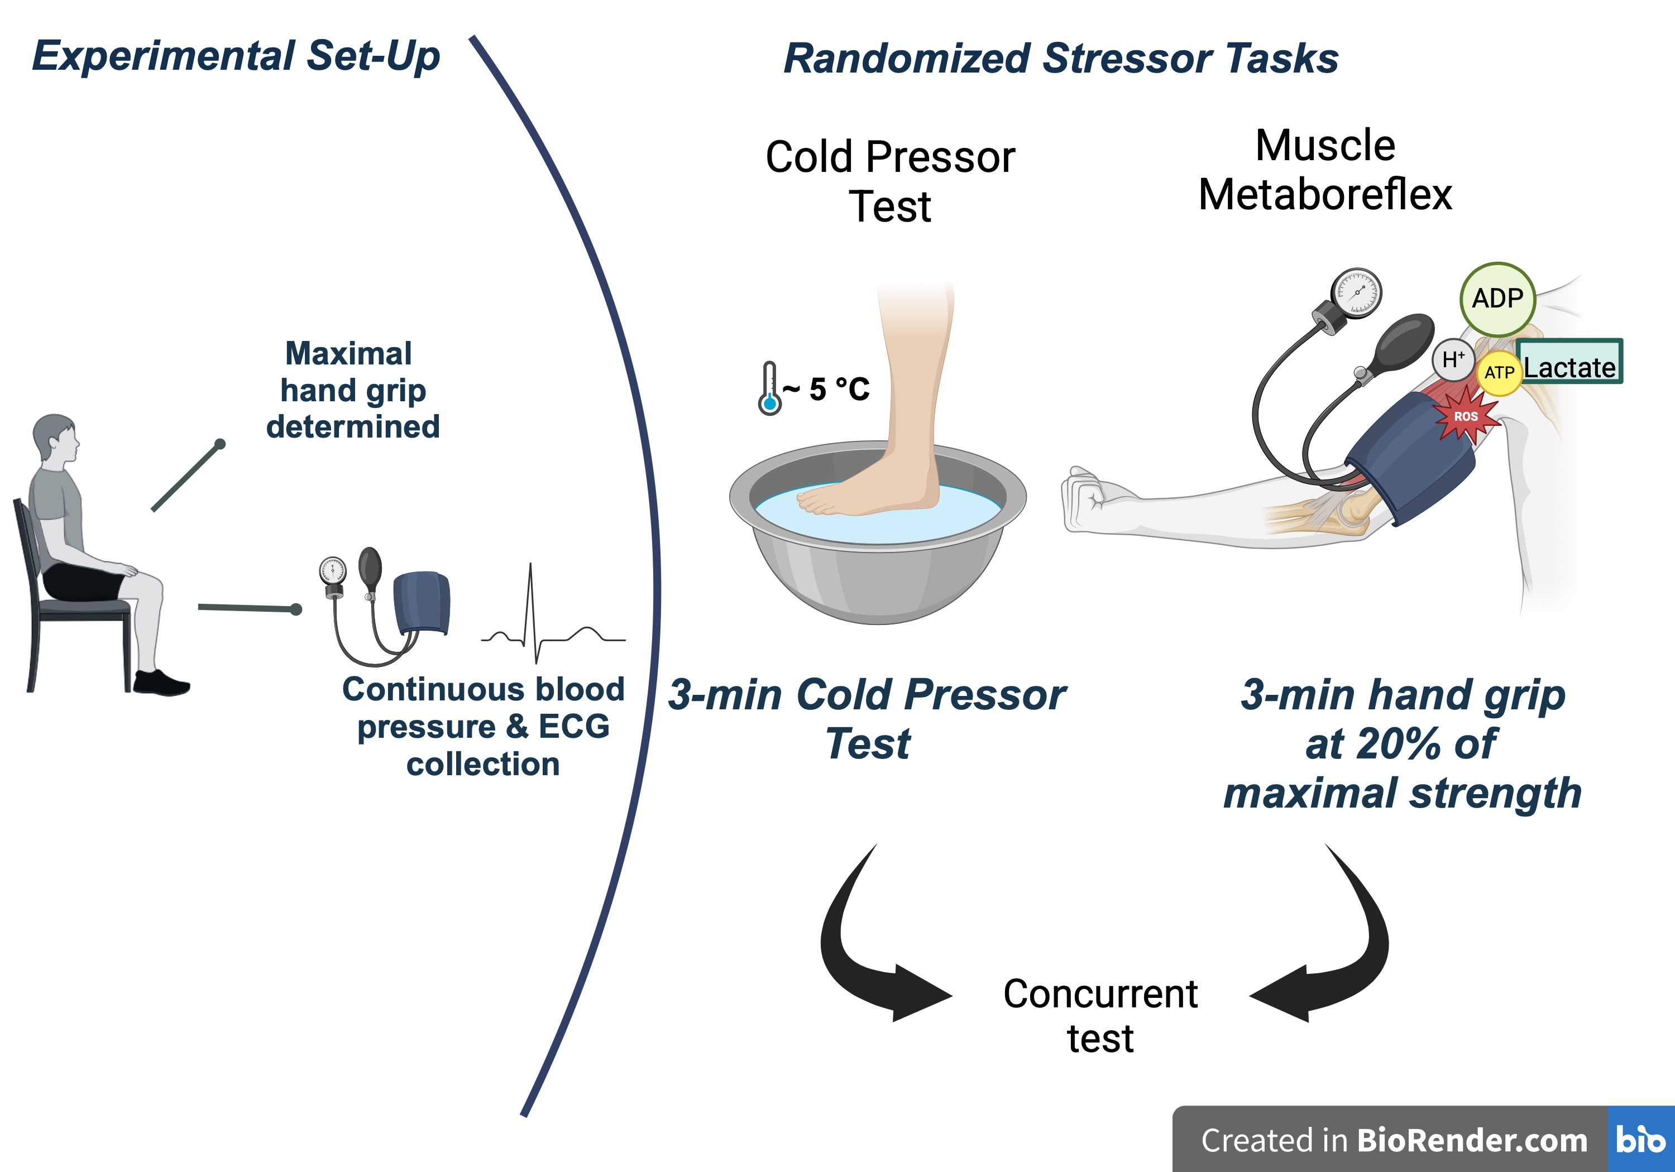
Impact of Concurrent Cold Pressor and Muscle Metaboreflex Responses via the Sympathetic Nervous System
Caitlin Forsyth, Parker Mills, & Kailey Wheeler
Biol 3550- Human Physiology II

Slide 2
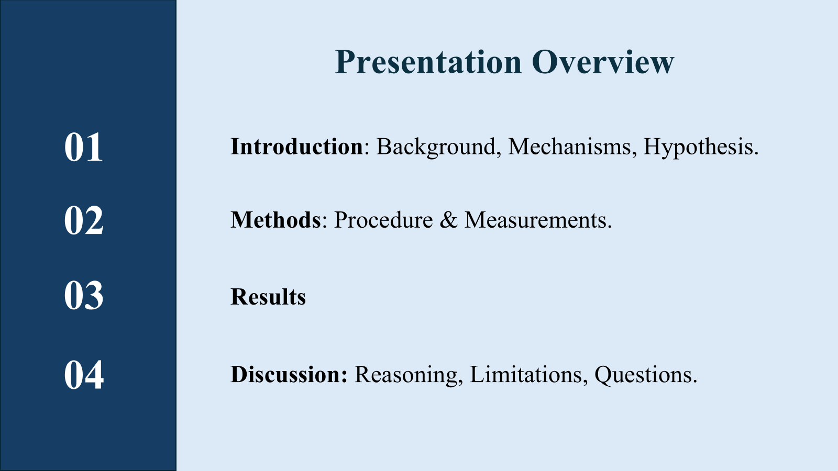

Why study both together?
?

Slide 3
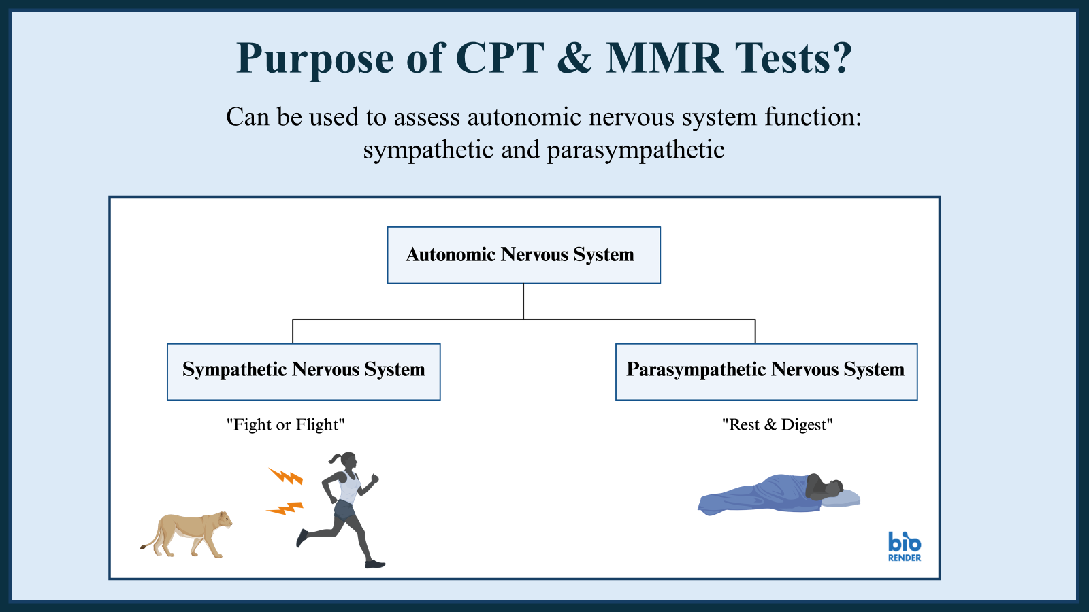

Slide 4
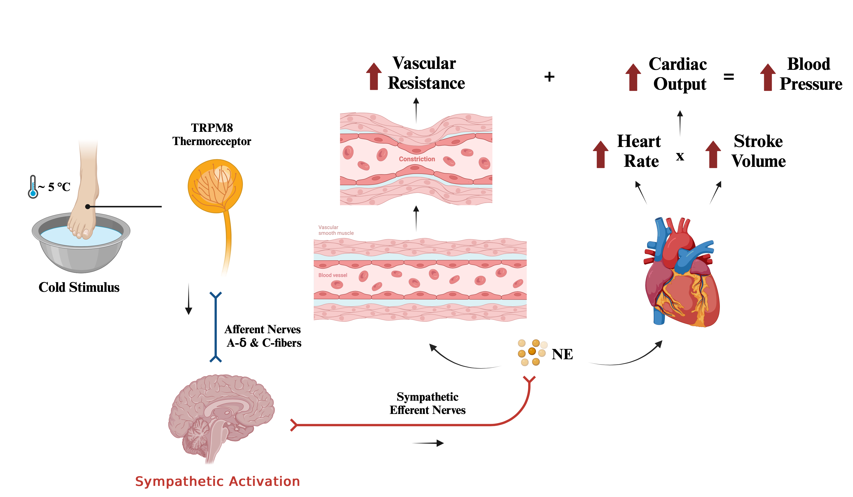
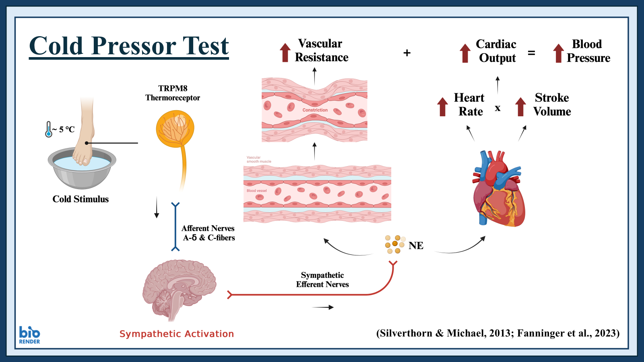
Cold Pressor Test
Citations

Slide 5
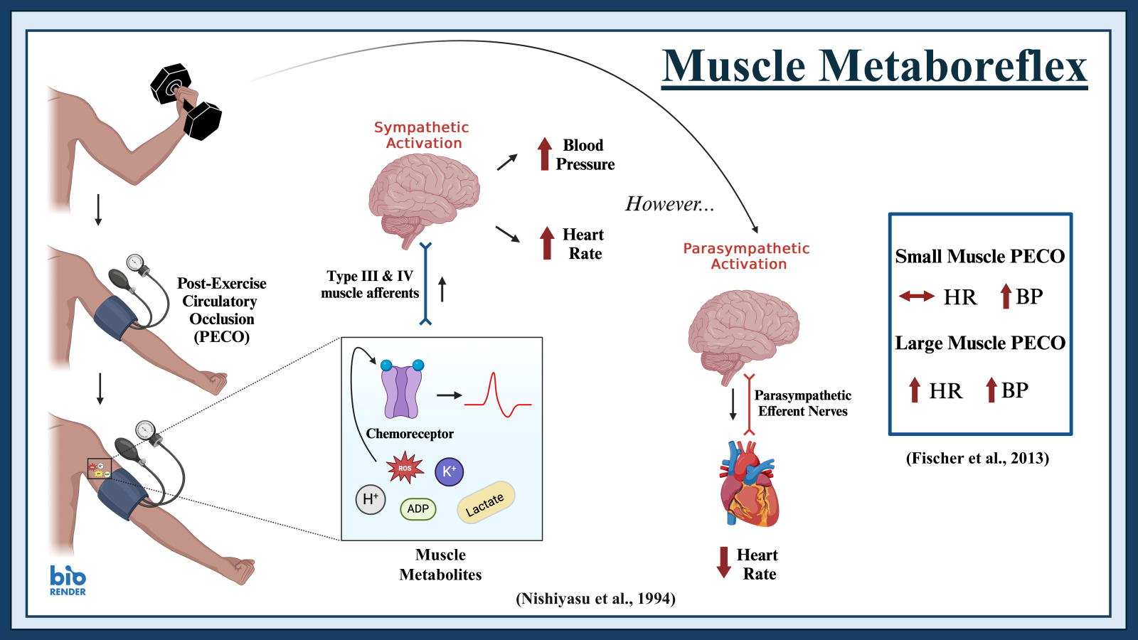
Muscle Metaboreflex
Muscle
Metabolites
(Fischer et al., 2013)
(Nishiyasu et al., 1994)

Slide 6
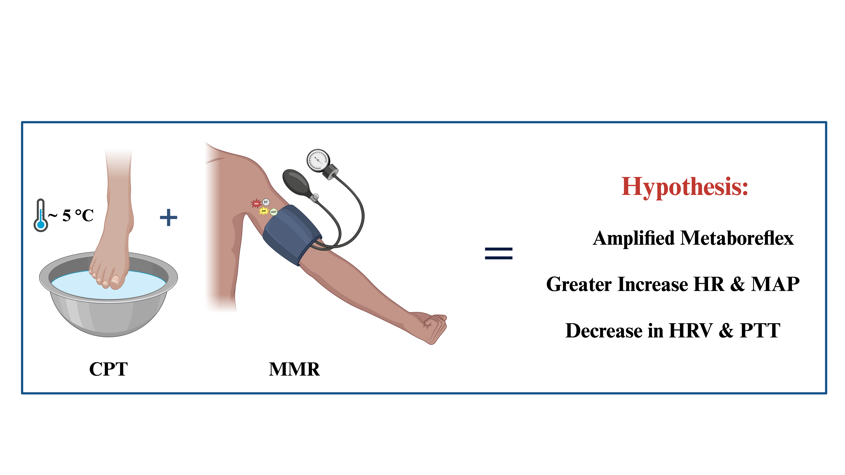
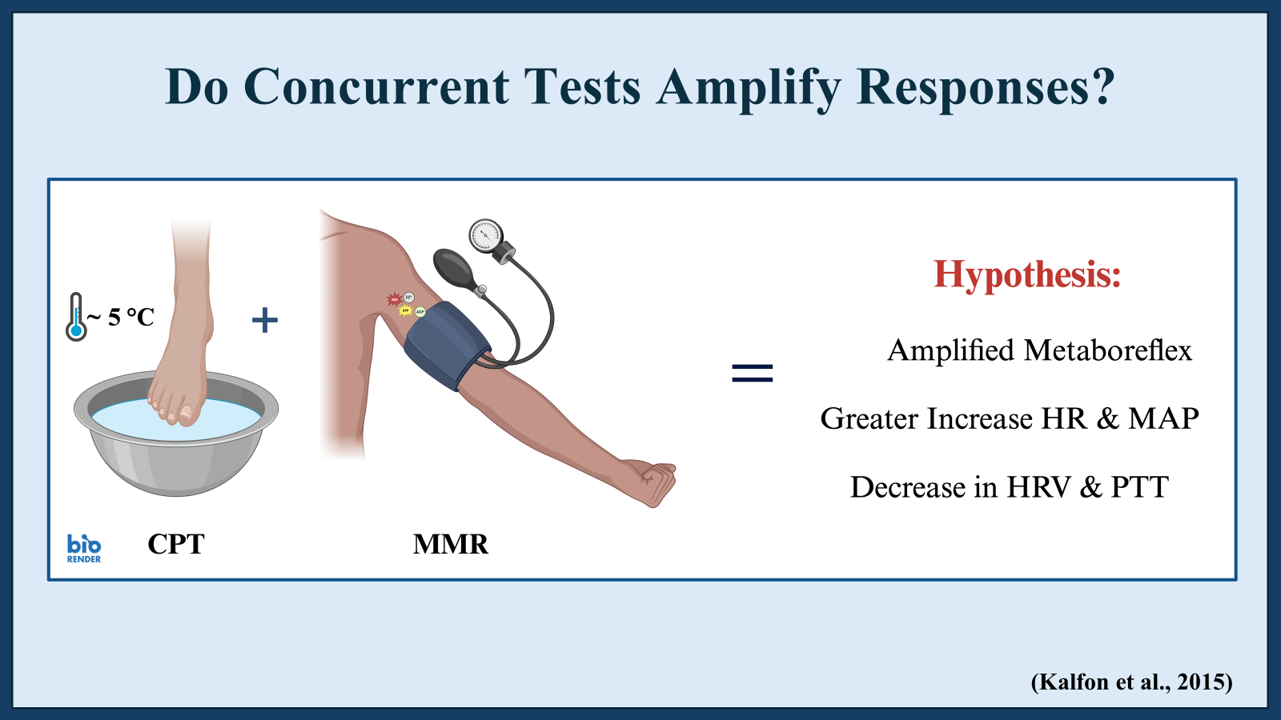

Do Concurrent Tests Amplify Responses?
(Kalfon et al., 2015)

Slide 7
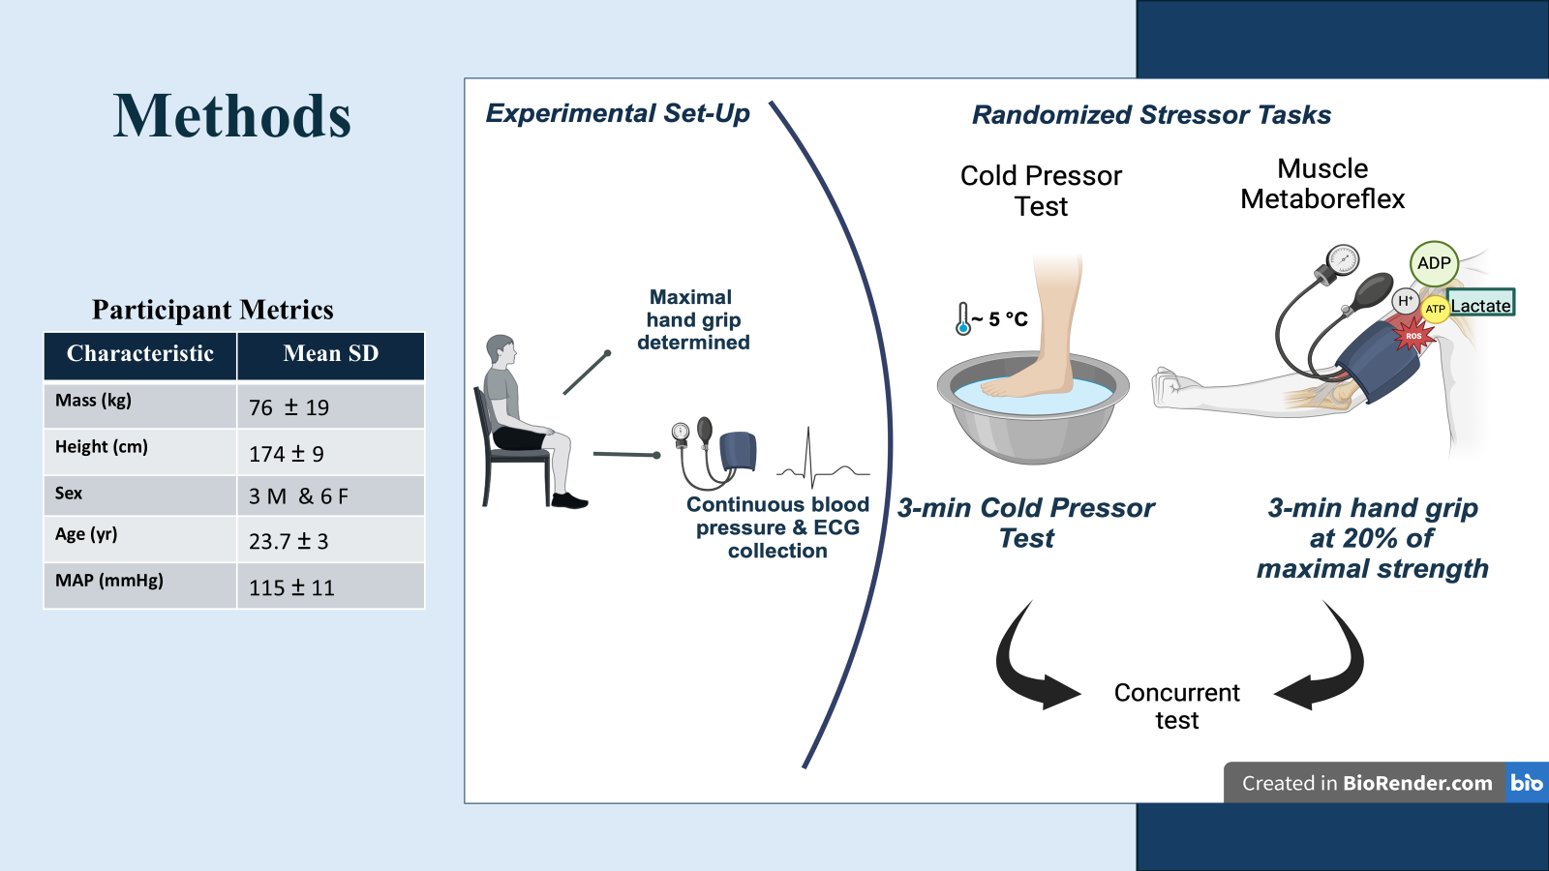

Methods
Participant Metrics
Characteristic | Participant
Mass (kg)
Height (cm)
Sex
Age
BP (mmHg)
Notes:
Need some participant data yahoo

Slide 8
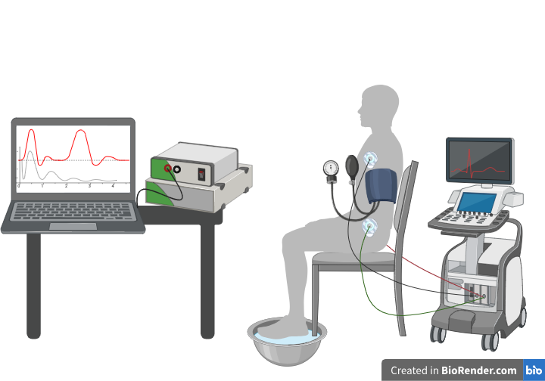
Measurements
Measurements:
Mean Arterial Pressure (MAP)
Heart Rate (HR)
Pulse Transit Time (PTT)
(Zhang et al., 2011)
Heart Rate Variability (HRV)
(Navarro-Lomaset al., 2020; Shaffer & Ginsberg, 2017)
Software:
AcqKnowledge
JASP
Microsoft Excel
HRVanalysis
Notes:
Explain HR, MAP, PTT, HRV (mention software and tools)

Slide 9
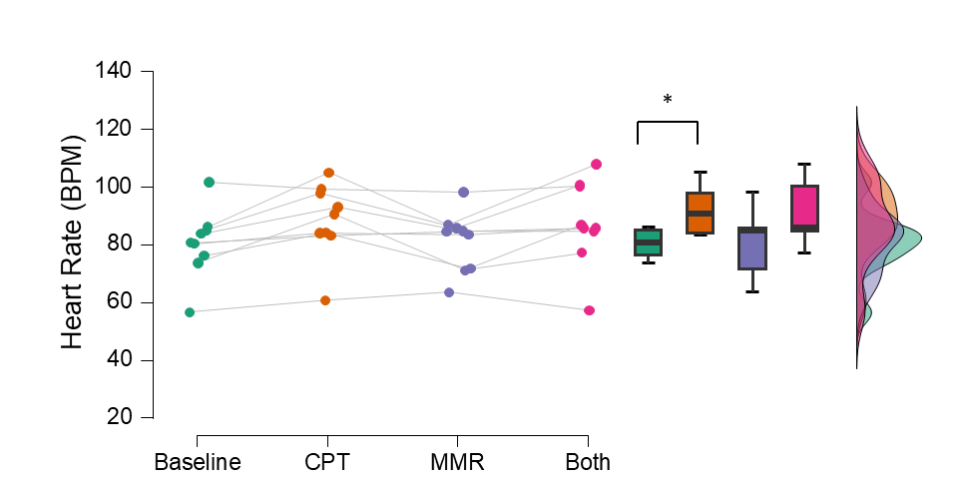
Results: HR
Increased by 8 BPM
Notes:
Add summary stats under each graph (p-values, significance) ⚠️ Use subtle animations: plot appears first, text builds in after
To do tonight- add PECO, CPT etc guide. MSNA for discussion
-add figure captions and transitions

Slide 10
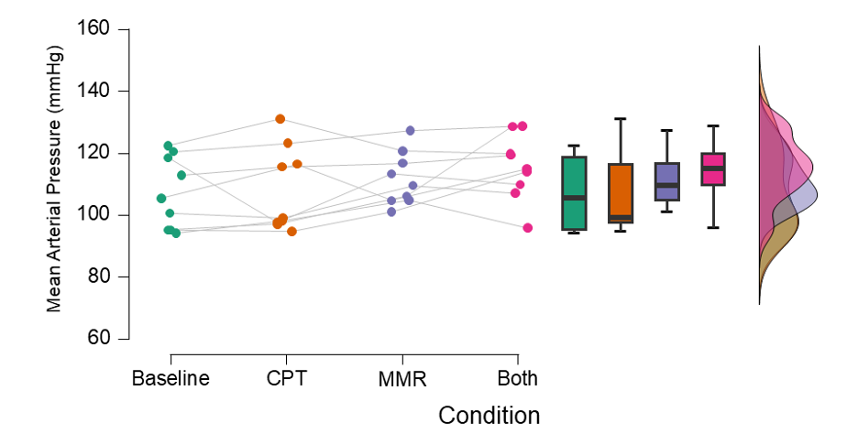
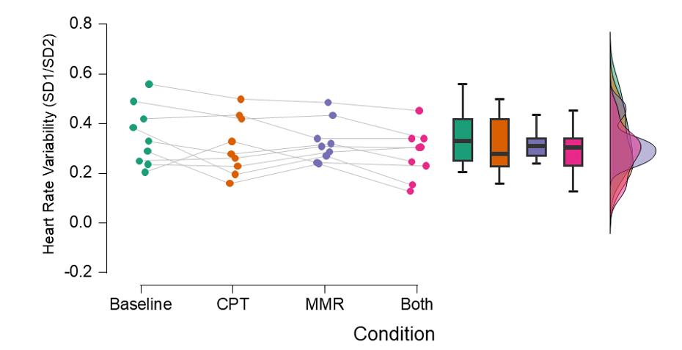
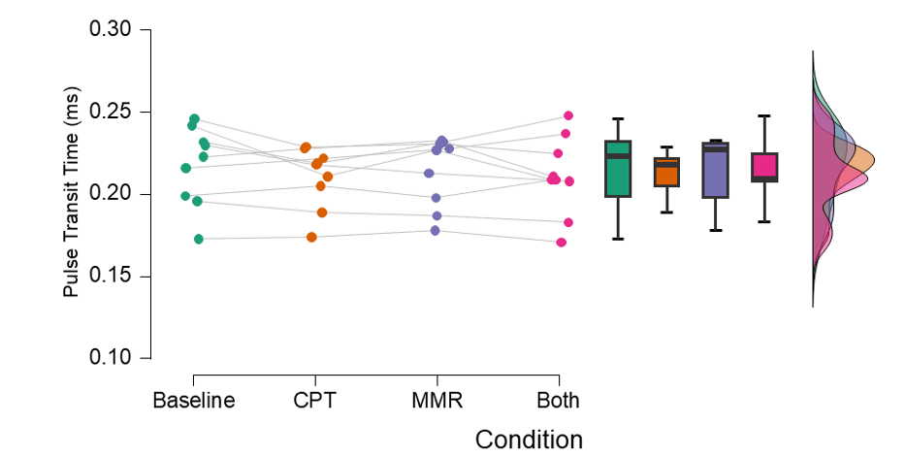
Results: MAP
Results: HRV
Results: PTT
Notes:
Add summary stats under each graph (p-values, significance) ⚠️ Use subtle animations: plot appears first, text builds in after

Slide 11

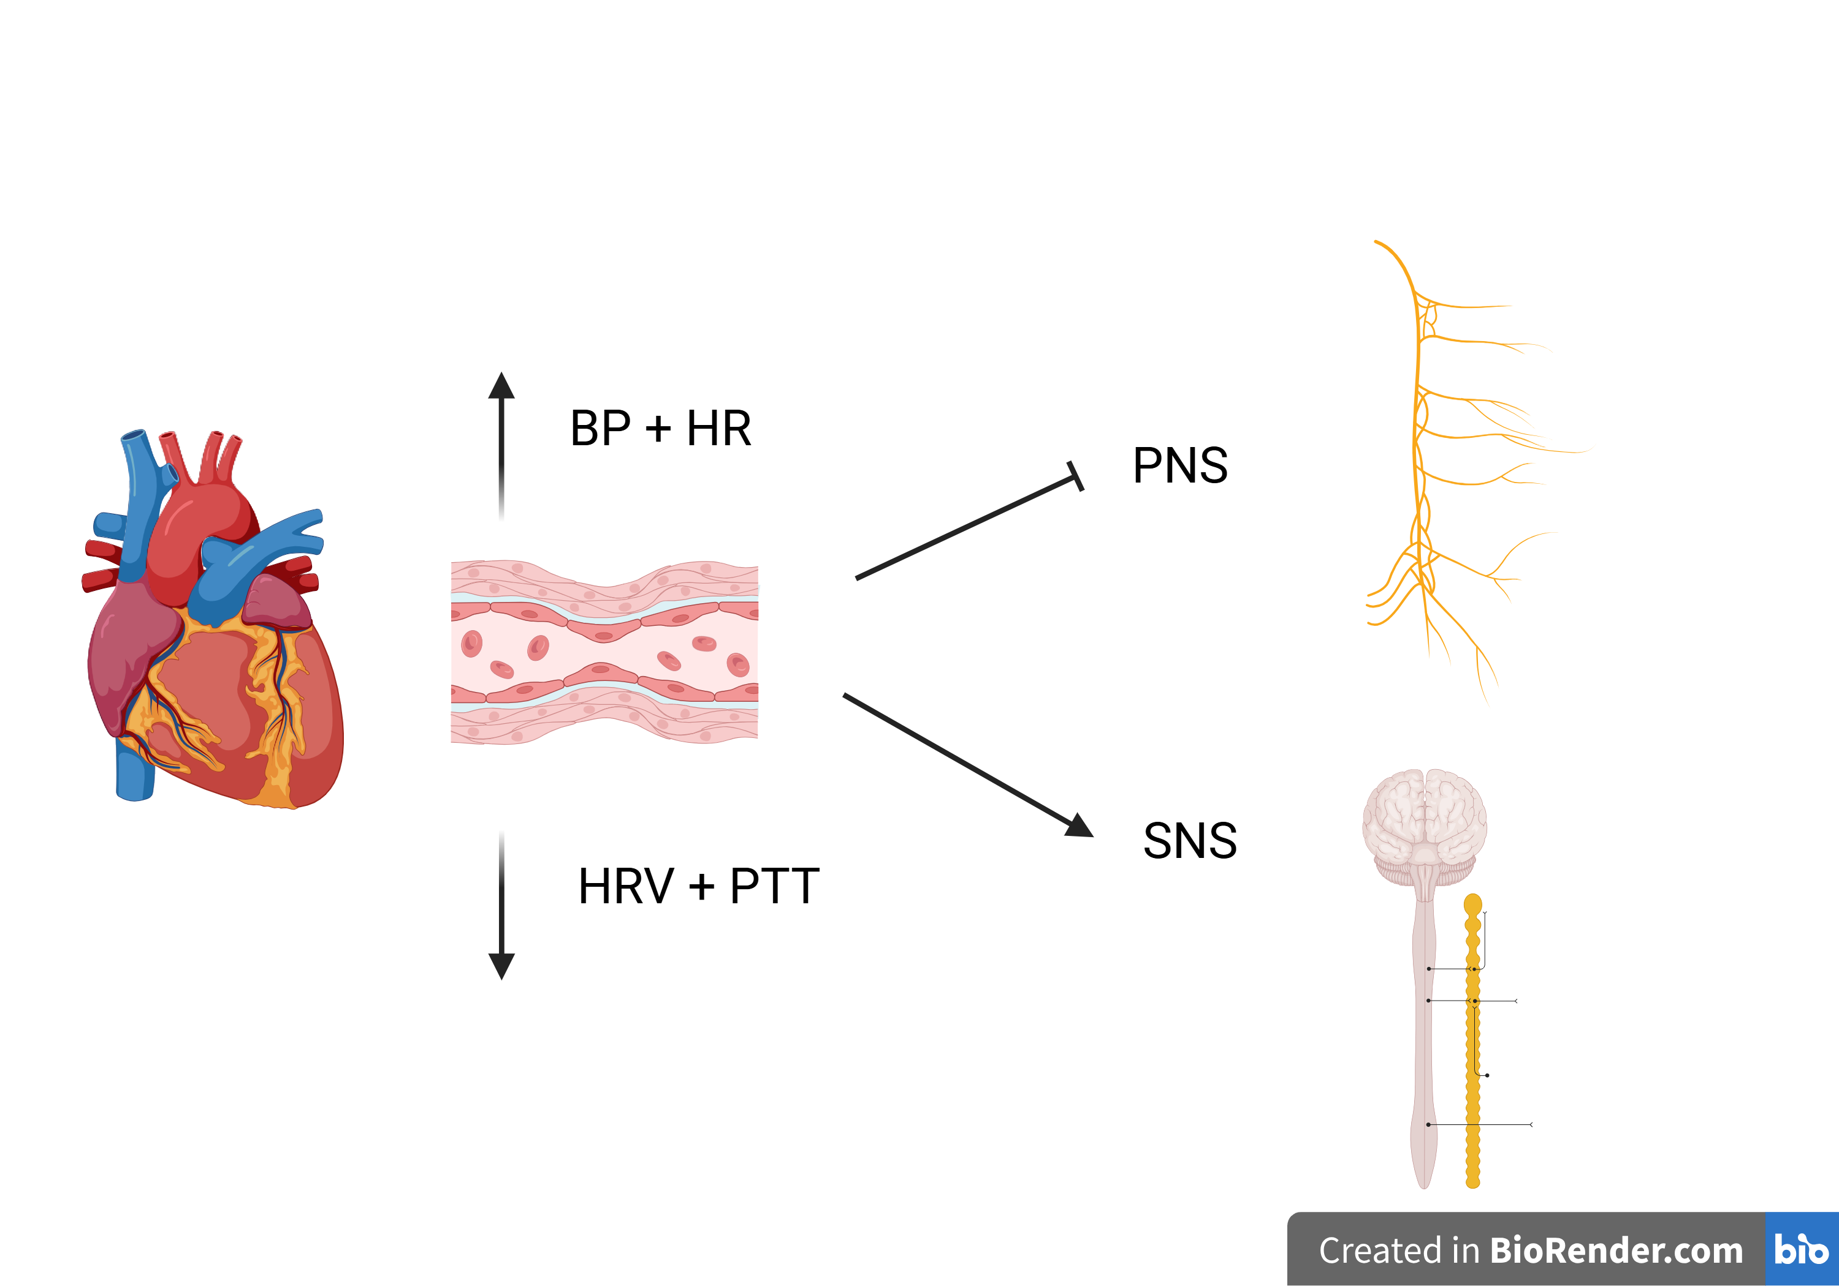
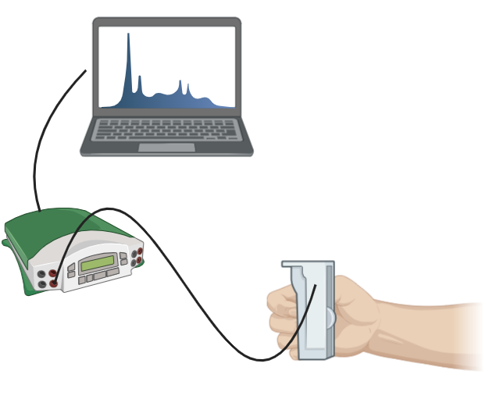
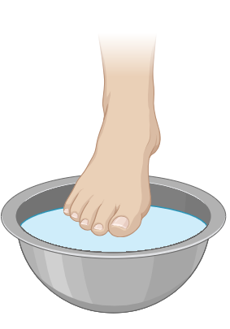
Discussion
Big Idea!
If the MMR and CPT both increase sympathetic activity, then combining them should have a cumulative effect and override any parasympathetic activity.
(Cui et al., 2001, Fisher et al., 2010; Iellamo et al., 1994; Nishiyasu et al., 1994)
(Kalfon et al., 2015)

Slide 12
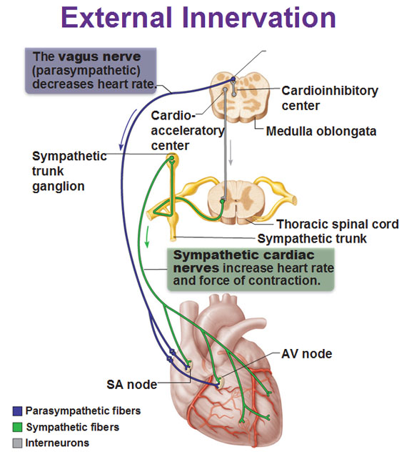
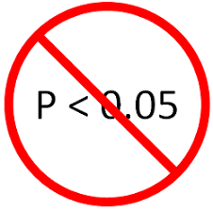

Discussion
Only significant finding!
HR increased during CPT compared to baseline
Differences between HR, BP, HRV and PTT all had no statistical significance between conditions….
Sympathetic Activation = NE on SA node of heart
(Charkoudian & Rabbits 2009; Elias & Ayji, 2019)
https://antranik.org/conducting-system-of-the-heart/. (Retrieved March 31, 2025)

Slide 13
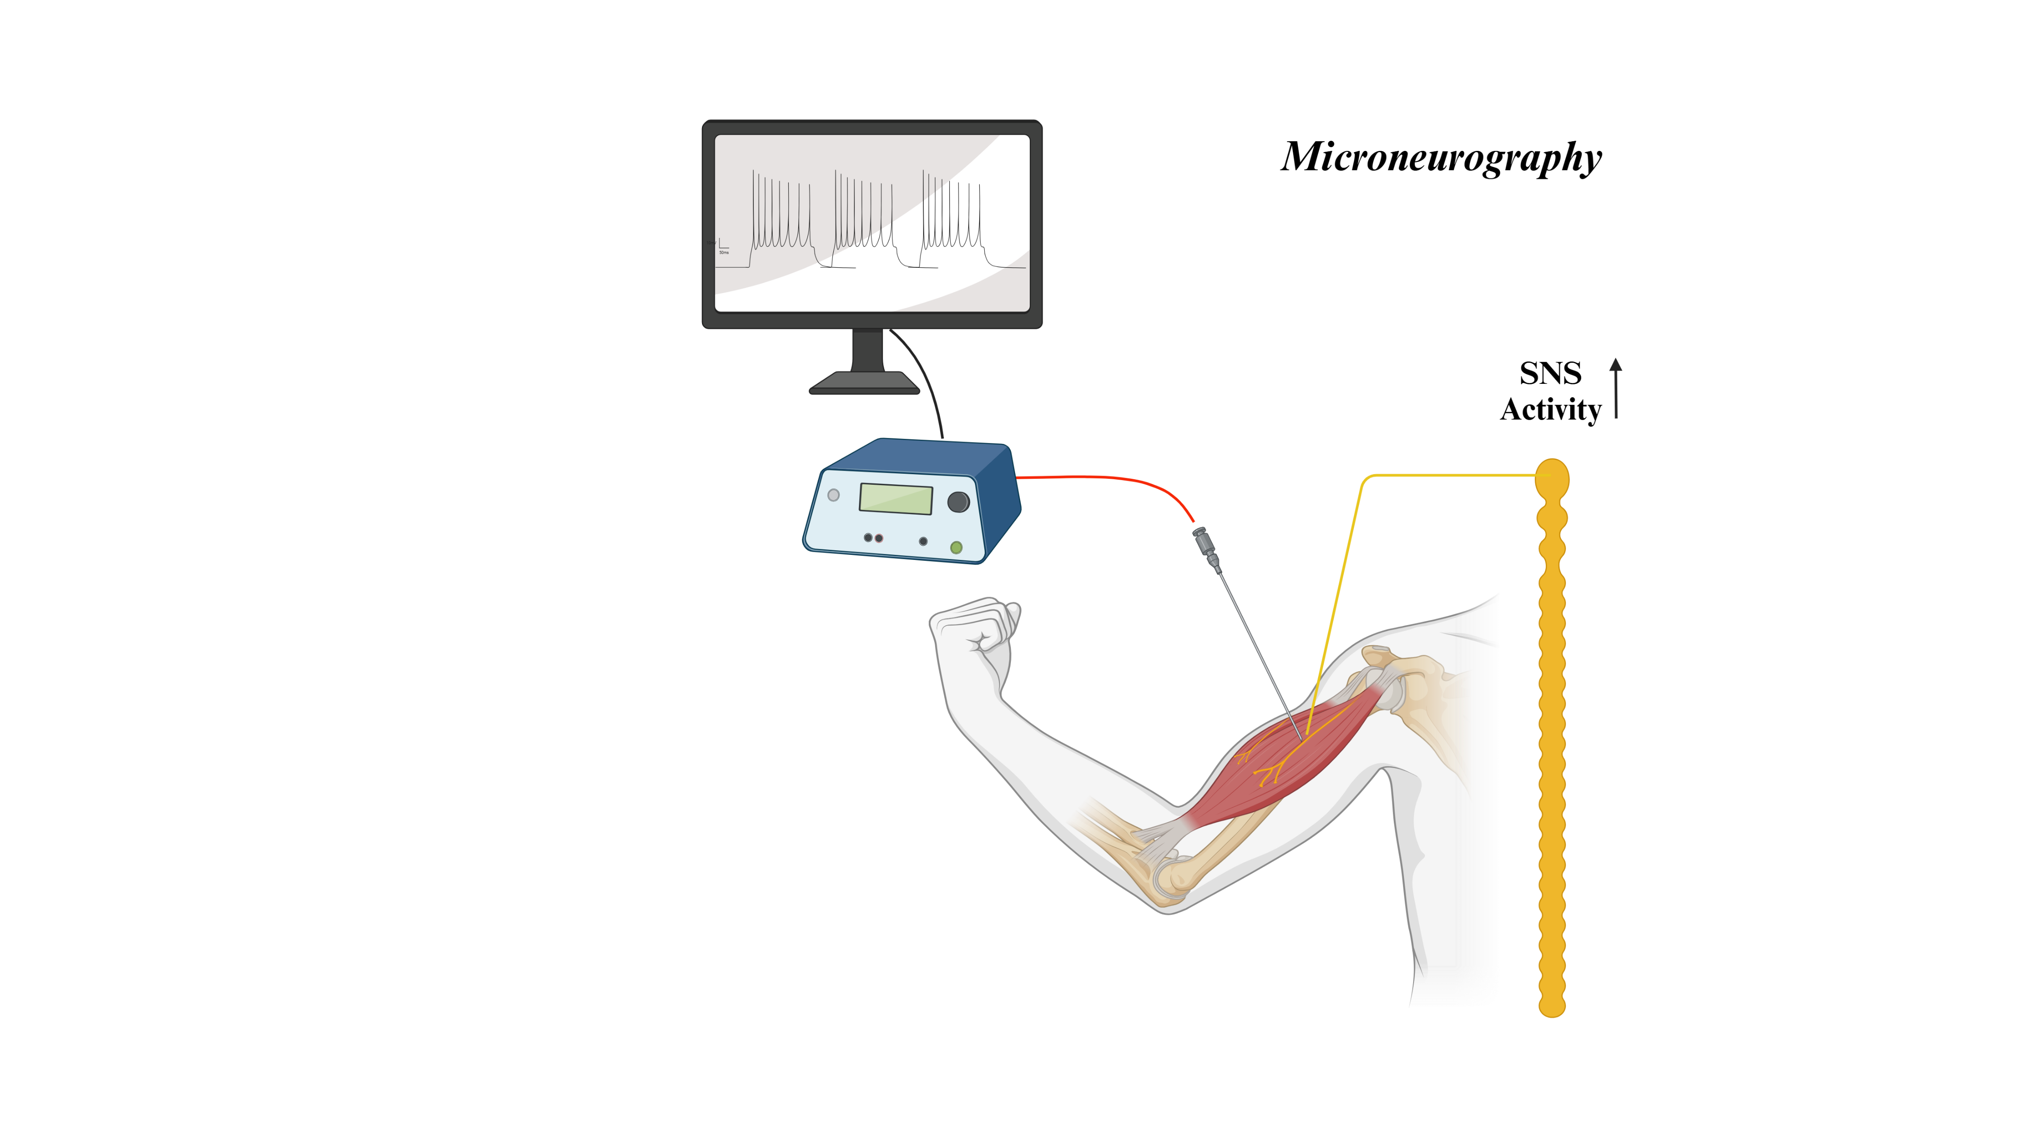
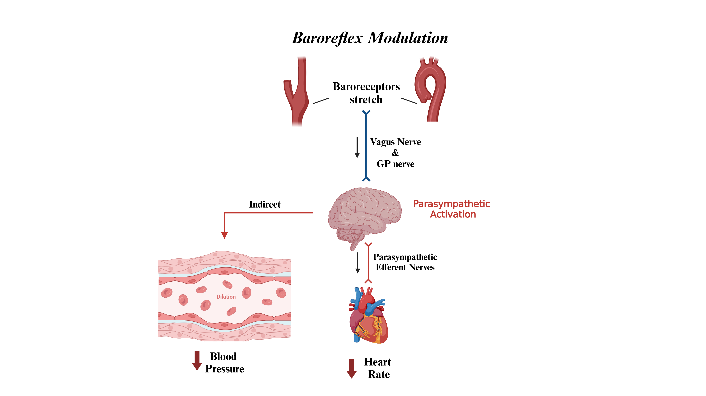
Discussion
Stimulus Intensity → MSNA via microneurography (Kregel et al., 1992; White et al., 2015)
Baroreflex modulation could reduce CV responses (Cui et al., 1985; Cui et al., 2002)
Dynamic exercise with partial hindlimb ischemia in dogs supports this (Sheriff et al., 1990)
PECO after isometric HG not able to override baroreflex (Fisher et al., 2008)

Slide 14
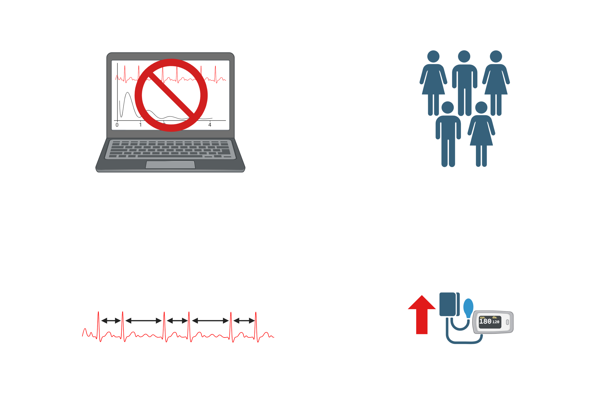
Limitations/Sources of Error
No Baseline For Each New Condition
Small Sample Size
(n = 17 for power)
HRV Inter-Subject Variability
(Jauregui-Renaud et al., 2001)
High Resting BP
(Fabian et al., 2016)
Stress = SNS = Confound
(Bigalke et al., 2023)

Slide 15
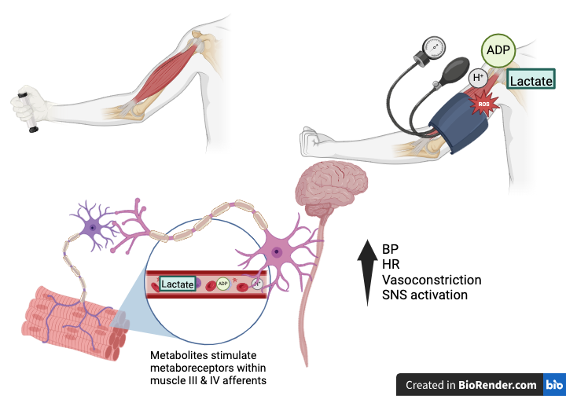
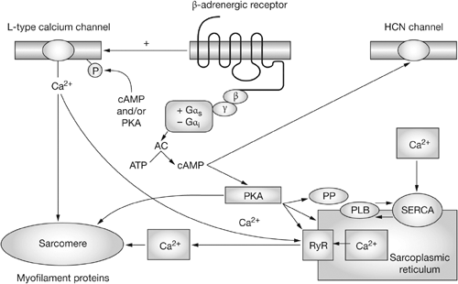
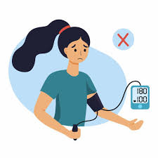
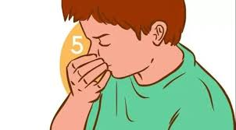


Future Directions
Delaney et al., 2010
(Zygmunt & Stanczyk, 2010)
Hypertensive vs Normotensive Responses
Use a Valsalva maneuver to measure autonomic function prior to testing.
(Feldman et al., 2005) – Receptor Mechanism
(Fisher et al., 2013) – MMR Beta-Blockers
(Crisafulli et al., 2006)
Vary MMR exercise intensity with CPT and measure metabolites to view different mechanisms of sympathetic activation
Receptor antagonists to view affects of sympathetic vs parasympathetic activity

Slide 16
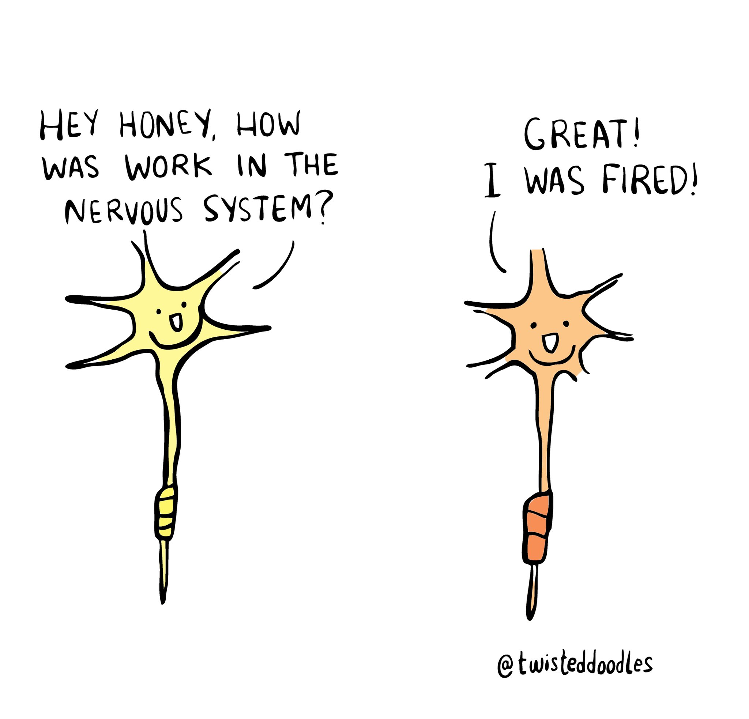
Questions?

